Slide 1
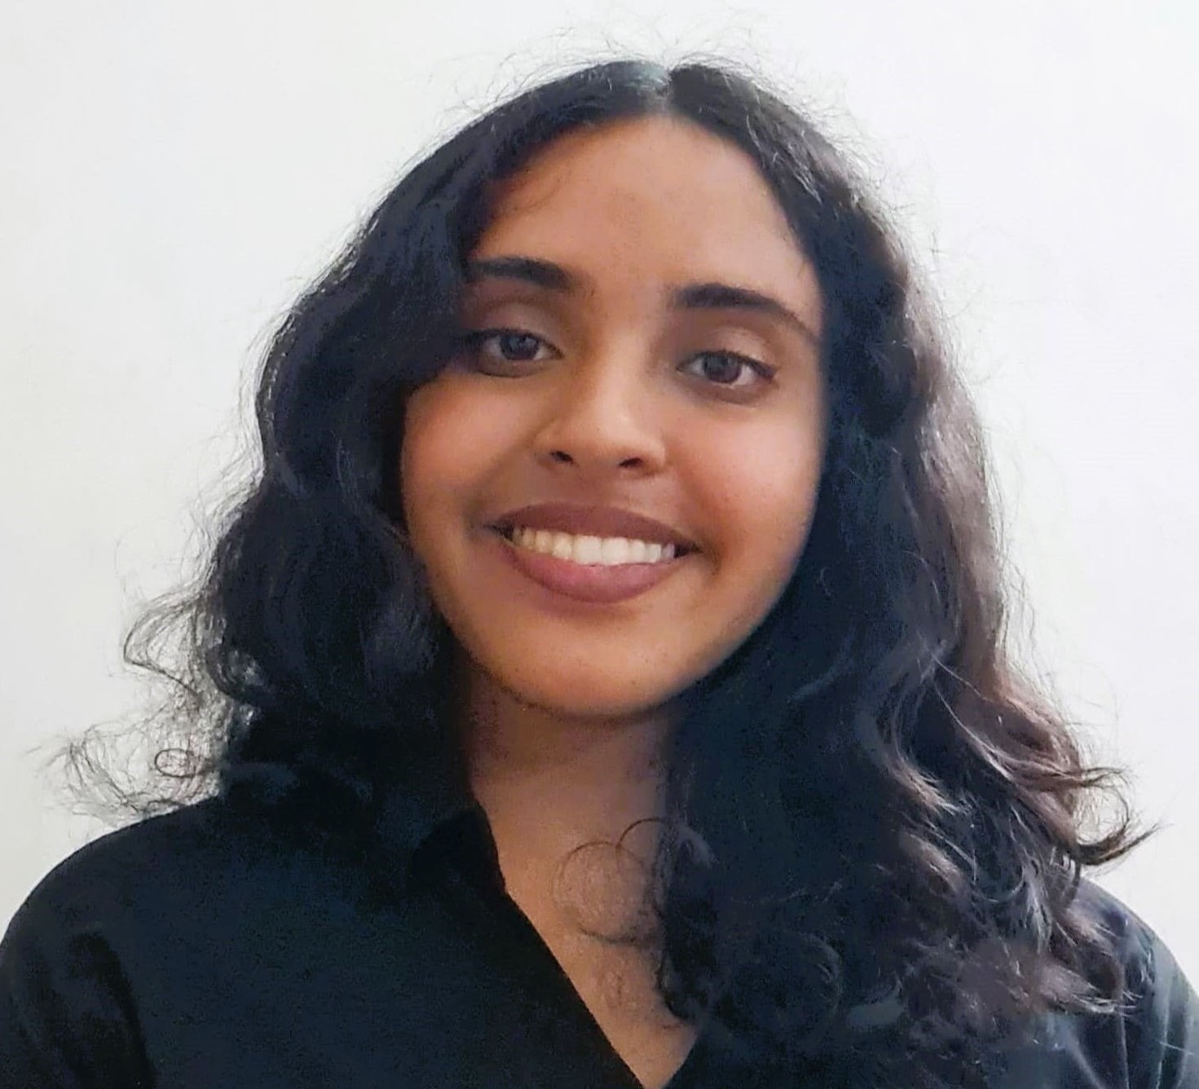
Shell Bootcamp 2024 3 Reflections for Week 1 [26-Aug-24 to 30-Aug-24]
Sumona Sud
Date : 30-Aug-2024

Slide 2

About Me
Drive with ambition, deliver with dedication, and uphold quality.

Slide 3

My learnings from this week!

Slide 4

Learning 1 | My takeaways
Please share (in your own words) details of the learning.
Importance of having the right mindset
Being open to criticism and feedback
Learning the importance of teamwork and collaboration

Slide 5

Learning 2 | My takeaways
Please share (in your own words) details of the learning.
Confidence and the right way to present
Building up confidence and keeping your audience engaged with your presentations
Presentations are key in all corporate settings, learning how to make the right presentations can help deliver udpates in an engaging way

Slide 6

Learning 3 | My takeaways
Please share (in your own words) details of the learning.
Agile methodologies and terminologies
Understanding the project development lifecycle and its various stages
Projects in the IT Department all deal with these terminologies

Slide 7

Relevance of learnings for my organization

Slide 8
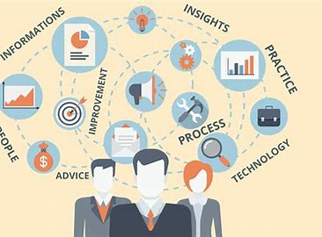
Learning 1 | Relevance for Shell
Learning the soft skills and important vocabulary that is required in a corporate setting was key. Also, I understood the importance of a good mindset as well as a learning behavior. We will implement these learnings every day in shell.

Slide 9

Learning 2 | Relevance for Shell
Teamwork and collaboration are key throughout shell. Learning how to effectively communicate and collaborate with all the team members leads to a more productive and healthy work environment. Through the trainings, I have learnt how not only to confidently put up my points but also to actively listen to the points of my peers and team members. This learning is key to having a good career at Shell.

Slide 10
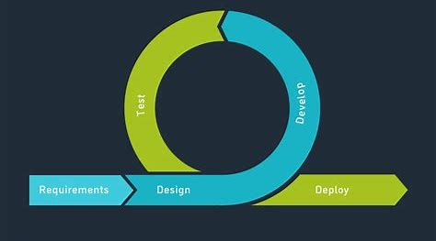
Learning 3 | Relevance for Shell
Agile methodologies, such as Scrum and Kanban, emphasize iterative development, flexibility, and collaboration. Key terminologies include sprints, backlogs, and user stories. In a corporate environment, Agile fosters adaptability, enhances team communication, and accelerates project delivery, leading to more efficient and responsive workflows. This is key in the corporate world like Shell.

Slide 11

Challenges in implementing learning

Slide 12

Challenge faced while implementing Learning 1
Overcoming my nervousness of speaking in front of all the peers was a challenge I faced. Developing the right mindset and understanding team collaboration is important.

Slide 13
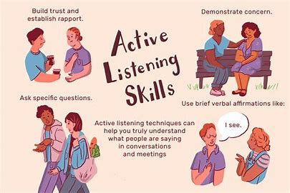
Challenge faced while implementing Learning 2
A challenge I faced is implementing active listening with my peers. Making the right decisions in a social corporate setting is extremely important and can make a big impact on your teamwork and collaboration.

Slide 14
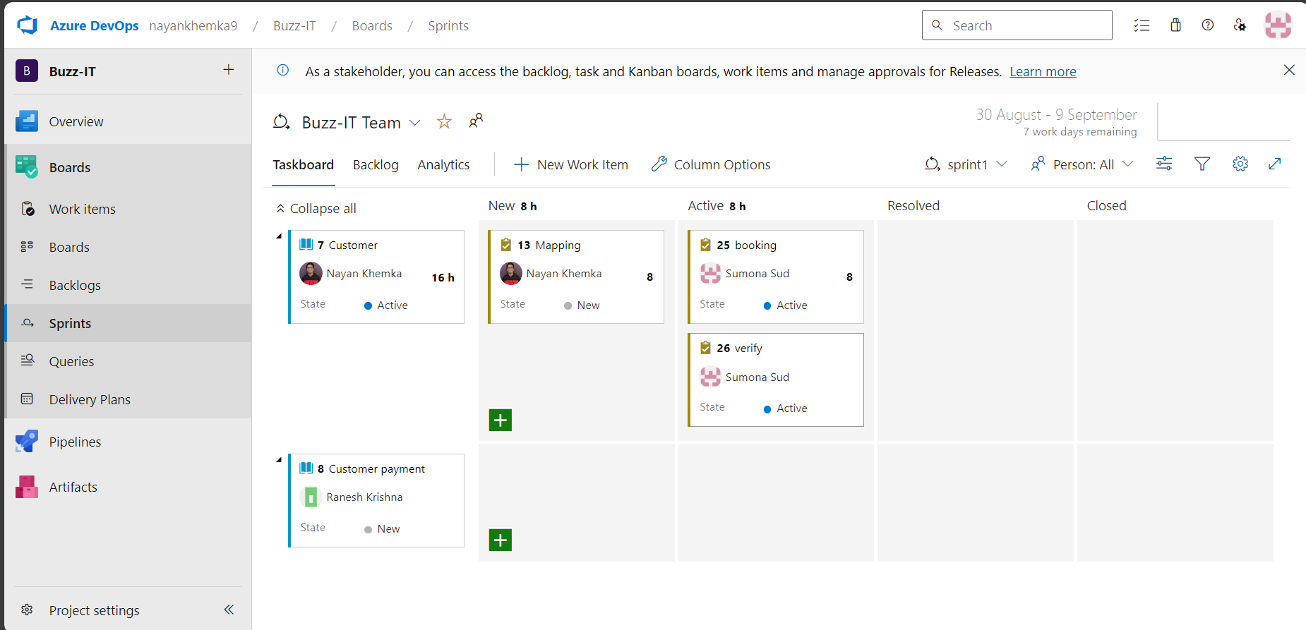
Challenge faced while implementing Learning 3
Working with Agile Methodology and implanting appropriate scrum techniques was a first for me. Through Azure devops we were able to effectively understand how sprints, scrum and team collaboration on projects occurs. We also created UI solutions for our project.
GitHub Repo- Sumona Sud

Slide 15

Action Plan

Slide 16
My Action Plan for this Week
Actions
Timeline
Status
Understanding the importance of soft skills and implementing them in the corporate world. Evolving my mindset and practicing confidence for efficiency in team collaboration in further meetings. Revising the terminologies frequently used in BA and the agile methodologies.
The timeline for the softskills is the course of the first week of September and the BA terminologies have been understood during this week.
Have understood much of the soft skills. Instilling confidence in myself and my ideas can be worked on. Have understood the BA terminologies

Slide 17

Learning is also Fun!

Slide 18
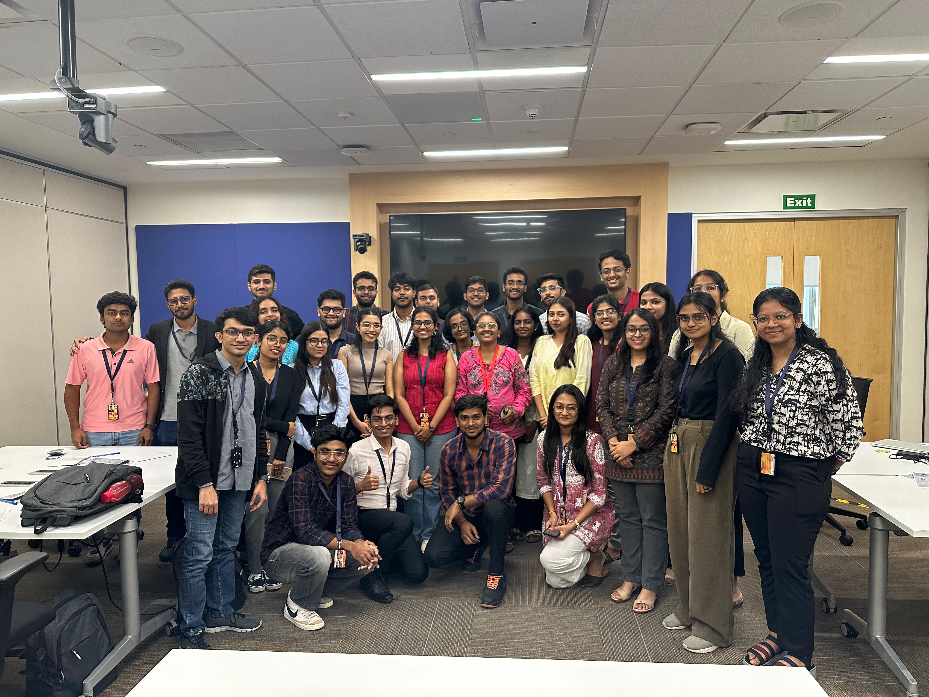
Learning is also Fun!
Please share how ”Your” learning was fun this week
A group activity where we had to do team presentation was very fun.
The topic for our team was a persuasive presentation and we chose to persuade our peers to buy a product called “SoggySocks”

Slide 19

Summary
In conclusion, throughout the course of the first week of the Unext Training Bootcamp I learnt the importance of confidence and team work in the work place. I learnt about having the right mindset when you step into the workplace and creating the right environment for everyone. Understanding BA terminologies were key for myself as well, in the BA role.
The next few topics are key in any developers work life. These are the devops, cloud, DBMS topics which are very important. Being a BA, I would have to have knowledge of all these topics to effectively contribute to my team.
In the last two days of week1, we learnt about Software lifecycle models and business analysis. These are the necessary to know before delving into developing any project in the IT realm as they deal with the planning of the projects before implementing the devops/cloud/DBMS functionalities.

Slide 20
Thank You

